Slide 1
Nominal and Effective Interest Rates_ Continuous and Discreet Compounding_ Actual and Real Dollars
Dr. Hassan Ashraf
Assistant Professor_ Civil Engineering Department _ CU Islamabad _ Wah Campus

Slide 2
Nominal Interest Rates
So far the implicit assumption was that payments are received once a year, or annually.
However, some of the most familiar financial transactions, both personal and in engineering economic analysis, involve payments that are not based on annual payment – for example, monthly mortgage payments and quarterly earnings on savings accounts. Thus, if we are to compare different cash flows with different compounding periods , we need to evaluate them on a common basis. This need has led to the development of the concepts of nominal interest rate and effective interest rate.

Slide 3
Nominal Interest Rates
Even if a financial institution uses a unit of time other than a year – say, a month or a quarter (e.g., when calculating interest payments) – the institution usually quotes the interest rate on an annual basis. Many banks, for example, state the interest arrangement for credit cards in this way:
18% compounded monthly
This statement simply means that each month the bank will charge 1.5% interest on an unpaid balance.

Slide 4
Nominal Interest Rates
Even if a financial institution uses a unit of time other than a year – say, a month or a quarter (e.g., when calculating interest payments) – the institution usually quotes the interest rate on an annual basis. Many banks, for example, state the interest arrangement for credit cards in this way:
18% compounded monthly
This statement simply means that each month the bank will charge 1.5% interest on an unpaid balance. We say that 18% is the nominal interest or annual percentage rate (APR), and the compounding frequency is monthly (12). To obtain the interest rate per compounding period, we divide, for example, 18% by 12 , to get 1.5% per month.

Slide 5
Nominal Interest Rates
Although Annual Percentage Rate (APR) or nominal interest rate is commonly used and is familiar to customers, the nominal interest rate does not explain precisely the amount of interest that will accumulate in a year. To explain the true effect of more frequent compounding on annual interest amounts, we will introduce the term effective interest rate, commonly known as annual effective yield, or annual percentage yield (APY).

Slide 6
Nominal Interest Rates
1.5 | 1.5 | 1.5 | 1.5 | 1.5 | 1.5 | 1.5 | 1.5 | 1.5 | 1.5 | 1.5 | 1.5
1.5% x 12 = 18%

Slide 7
Effective Annual Interest Rates
The effective annual interest rate is the one rate that truly represents the interest earned in a year.
Suppose you deposit $10,000 in a savings account that pays you at an interest rate of 9% compounded quarterly. Here, 9% represents the nominal interest rate, and the interest rate per quarter is 2.25% (9%/4).

Slide 8
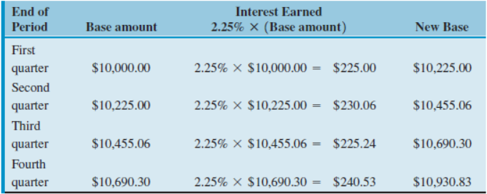
Effective interest rate

Slide 9
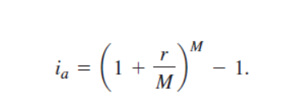
Effective Interest Rate
Effective Interest Rate= 930.83/10,000 = 9.38%

Slide 10
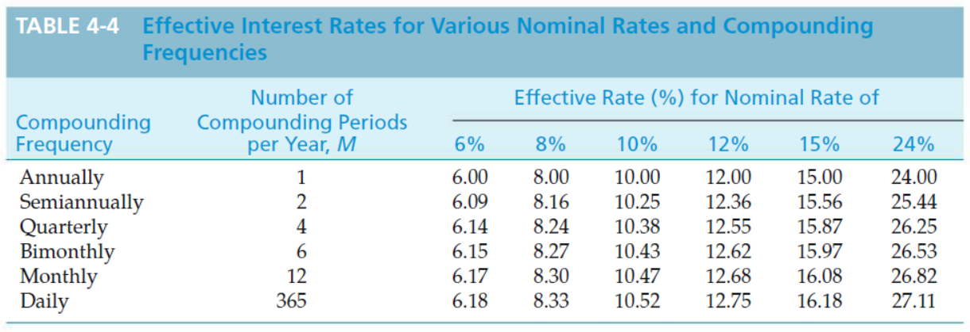
Effective w.r.t Nominal Interest Rates

Slide 11
Compounding more often than once per year
Suppose that a $100 lump-sum amount is invested for 10 years at a nominal interest rate of 6% compounded quarterly. How much is it worth at the end of the 10th year?
Principal = $ 100
N = 10 years
i = 6%
FW of $ 100 amount at the end of 10 years = ?
Lets assume the question provides interest rate as 6% compounded annually, te solution would have been straight forward.
F= 100 (F/P, 6%,10) = 100 (1.791) = $179.1
However, the question gives us the interest rate that is compounded quarterly. What we can do is we can find out the nominal interest rate per quarter which is 6%/4 =1.5%. Once we have interest rate on quarterly basis, we need to have interest periods also in quarters to match the nominal interest rate calculated on quarterly basis.
F = 100 (F/P, 1.5%,40) = 100 ( 1.814) = 181.4

Slide 12
Compounding more often than once per year
Stan Moneymaker has a bank loan for $10,000 to pay for his new truck. This loan is to be repaid in equal end-of-month installments for five years with a nominal interest rate of 12% compounded monthly. What is the amount of each payment?
P = $10,000 , interest rate = 12 % compounded monthly , A=? N = 5 years
Lets assume that the interest rate is given as 12% compounded annually and the installments are to be paid back on yearly basis. In this case, the solution would have been:
A = 10,000( A/P, 12%,5) = 10,000 ( 0.2774) = $2774/year
However, because the interest rate is compounded monthly , the nominal interest rate on monthly basis would be 12%/12 = 1% . And as the interest rate has now been converted on monthly basis, the interest periods need to match nomenclature of interest. Therefore, the interest periods on monthly basis would become 5 x 12 = 60
A = 10,000 (A/P, 1%,60) = 10,000 (.0222) = 222/ month

Slide 13
Continuous Compounding
To be competitive on the financial market or to entice potential depositors, some financial institutions offer frequent compounding. As the number of compounding periods (M) becomes very large, the interest rate per compounding period (r/M) becomes very small. As M approaches infinity and r/M approaches zero, we approximate the situation of continuous compounding.

Slide 14
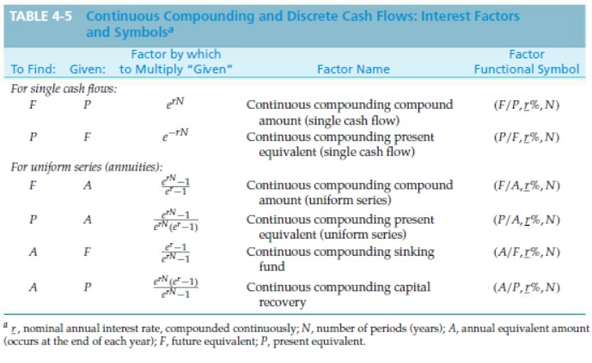
Continuous and Discrete Compounding

Slide 15
Continuous and Discrete Compounding
You have $10,000 to invest for two years. Your bank offers 5% interest,
compounded continuously for funds in a money market account. Assuming no additional deposits or withdrawals, how much money will be in that account at the end of two years?
Solution
F = $10,000 (F/P, r = 5%, 2) = $10,000 e^(0.05)(2) = $10,000 (1.1052) = $11,052
Comment
If the interest rate was 5% compounded annually, the account would have been
worth
F = $10,000 (F/P, 5%, 2) = $10,000 (1.1025) = $11,025.

Slide 16
Continuous and Discrete Compounding
Suppose that one has a present loan of $1,000 and desires to determine what equivalent uniform EOY payments, A, could be obtained from it for 10 years if the nominal interest rate is 20% compounded continuously (M =∞).Solution
Here we utilize the formulation
A = P(A/P, r%, N).
Since the (A/P) factor is not tabled for continuous compounding, we substitute its inverse (P/A), which is tabled in interest tables for continuous compounding. Thus,
A = P × 1
(P/A, 20%, 10) = $1,000 × 1
3.9054 = $256.
Note that the answer to the same problem, with discrete annual compounding
(M = 1), is
A = P(A/P, 20%, 10) = $1,000(0.2385) = $239.

Slide 17
Continuous and Discrete Compounding
An individual needs $12,000 immediately as a down payment on a new home. Suppose that he can borrow this money from his insurance company. He must repay the loan in equal payments every six months over the next eight years. The nominal interest rate being charged is 7% compounded continuously. What is the amount of each payment?
The nominal interest rate per six months is 3.5%. Thus, A each six months is $12,000 (A/P,r = 3.5%,16). By using the formula to calculate A when P is given
A= P [ e^rn (e^r -1)/ (e^rn-1)] = 12000[1.7506 (1.035-1)/(1.7506-1)]
= 12000 [1.7506 (.035)/0.7506)]
=12000 [ .0613/0.7506]
= 12000 [ .08173]
= $981

Slide 18
Actual Dollars
The number of dollars associated with a cash flow ( or a noncash-flow amount such as depreciation) as of the time it occurs. For example, people typically anticipate their salaries two years in advance, in terms of actual dollars. Sometime, A$ are referred to as nominal dollars, current dollars, then-current dollars, and inflated dollars, and their relative purchasing power is affected by general price inflation or deflation.

Slide 19
Real Dollars
Dollars expressed in terms of the same purchasing power relative to a particular time. For instance, the future unit price of goods or services that are changing rapidly are often estimated in real dollars (relative to some base year) to provide a consistent means of comparison. Some times Real dollars are also termed as Constant Dollar.

Slide 20


The relationship between $A and $R
The relationship between actual dollars ( $A) and real dollars ($R) is defined in terms of the general price inflation ( or deflation) rate; that is, it is a function of f.
For a given b value. This relationship between actual and real dollars applies to the unit prices, or costs of fixed amount of individuals goods or services, used to develop (estimate) the individual cash flows related to an engineering project. The designation for a specific type of cash flow, j , would be included as :

Slide 21
The relationship between $A and $R
For a given b value, where the terms R$k,j and A$k,j are the unit price, or cost for a fixed amount, of goods or services j in period k in real dollar and actual dollars, respectively.

Slide 22
Real-Dollar Purchasing Power of Salary
Suppose that your salary is $45,000 in year one, will increase at 4% per year through year four, and is expressed in actual dollars as follows:
En of Year, k | Salary (A$)
1 | 45000
2 | 46800
3 | 48672
4 | 50619
If the general price inflation rate (f) is expected to average 6% per year, what is the real-dollar equivalent of these actual-dollar salary amounts? Assume that the base time period is year one (b=1)

Slide 23
Real-Dollar Purchasing Power of Salary
By using the above equation, we see that the real-dollar salary equivalents are readily calculated relative to the base time period- b =1
Year | Salary (R$, b=1)
1 | 45,000 (P/F,6%,0) = 45,000
2 | 46,800 (P/F.6%,1) = 44,151
3 | 48,672 (P/F,6%,2) = 43,318
4 | 50,619 (P/F, 6%,3) = 42,500
In year one ( the designated base time period for the analysis), the annual salary in actual dollars remained unchanged when converted to real dollars. This illustrates an important point.: In the base time period (b), the purchasing power of an actual dollar and a real dollar is the same. This example also illustrates the results when the actual annual rate of increase in salary (4% in his example) is less than the general price inﬂation rate(f).As you can see, the actual-dollar salary cash ﬂow shows some increase, but a decrease in the real dollar salary cash ﬂow occurs (and thus a decrease in total market purchasing power). This is the situation when people say their salary increases have not kept pace with market inﬂation.

Slide 24
Real-Dollar equivalent of Actual Cash flow
An engineering project team is analyzing the potential expansion of an existing production facility. Different design alternatives are being considered. The estimated after-tax cash ﬂow (ATCF) in actual dollars for one alternative is shown in column 2 of Table 8-1. If the general price inﬂation rate (f) is estimated to be 5.2%peryearduringtheeight-yearanalysisperiod,whatisthereal-dollarATCF that is equivalent to the actual-dollar ATCF? The base time period is year zero (b=0).
The ATCF in real dollars shown in column 4 has purchasing power in each year equivalent to the original ATCF in actual dollars.

Slide 25
Real-Dollar equivalent of Actual Cash flow
End of Year k | ATCF (A$) | (P/F,f%,k-b) | ATCF (R$)
0 | -172,400 | 1.0 | -172.400
1 | -21,000 | 0.9506 | -19,963
2 | 51,600 | 0.9036 | 46,626
3 | 53,000 | 0.8589 | 45,522
4 | 58,200 | 0.8165 | 47,520
5 | 58,200 | 0.7761 | 45,169
6 | 58,200 | 0.7377 | 42,934
7 | 58,200 | 0.7013 | 40,816
8 | 58,200 | 0.6666 | 38,796

Slide 26
Inflation and Household Income
Inthisexample,wereturntothequestionraisedinthechapteropener.According to government statistics, the median household income in the United States in 1953was$3,700peryear.BasedontheCPI,thisisequivalentto$30,000in2008. We can now answer t he following questions.
What was the annual compound rate of growth in median house hold income from1953 to 2008?
By 1978, median household income was actually $15,000. Based on your answer in Part(a), what is the equivalent household income in 2008?
(c) Was the actual median household income in 1978 higher than what you would have predicted in Part (a)? If so, give some reasons for this phenomenon.

Slide 27
Inflation and Household Income
The annual compound rate of growth is the interest rate that makes $3,700 in 1953 equivalent to $30,000 in 2008
$30,000 = $3,700 ( F/P,i%,55) = $3,700 (1+i’)^55
i% = 3.88% per year
Income 2008 = 15,000 (F/P, 3.88%,30) = $15,000 (3.133) = $46,995
Income 1978 = 3,700 ( F/P,3.88%,25) = $9,583
The actual 1978 income of $1,5000 is greater than $9,583 because more persons from an individual household were in the workforce in 1978 than in 1953. Also, the inflation rate may have exceeded 3.88% on the average during this time period.

Slide 28
Real-Dollar Equivalent of an investment
Suppose that $,1000 is deposited each year for five years into an equity (common stock) account earning 8% per year. During this period, general inflation is expected to remain at 3% per year. At the end of five years, what is the dollar value of the account in terms of today’s purchasing power (i.e., real dollars)?
Immediately after the fifth deposit, the actual dollar value of the equity account is
(A$) = $1000 (F/A,8%,5) = $ 5,866.60
The value of the account in today’s purchasing power is
R$ = 5,886.60 (p/F,3%,5) = $5,060.53

Slide 29
i_{m} and i_{r}
In general , the interest rate that is appropriate for equivalence calculations in engineering economy studies depends on whether actual-dollar or real-dollar cash-flow estimates are used:
Method | If cash flows are in terms of | Then the interest rate to use is
A | Actual Dollars (A$) | Market interest rate, i_{m}
B | Real Dollars (R$) | Real interest rate, i_{r}
This table should make intuitive sense as follows: If one is estimating cash flows in terms of actual ( inflated) dollars, the market interest rate (interest rate with an inflation/deflation component) is used. Similarly, if one is estimating cash flows in terms of real dollars, the real ( inflation-free) interest rate is used. Thus, one can make economic analyses in either the actual or real dollar domain with equal validity provided that the appropriate interest rate is used for equivalence calculations.

Slide 30
Relationship among i_{m} i_{r} and f
The above equations have showed that the relationship between an actual-dollar amount and a real-dollar amount of equal purchasing power in period k is a function of the general inflation rate (f). It is desirable to do engineering economy studies in terms of either actual dollars or real dollars. Thus, the relationship between the two dollar domains is important, as well as the relationship among im, ir, and if, so that the equivalent worth of a cash flow is equal in the base time period when either an actual or a real dollar analysis is sued. The relationship among these factors is
1+im = (1+f) (1+ir)
Im = ir + f+ ir (f)
Ir = im-f/ 1+f
Similarly, based on the above equation, the IRR of a real dollar cash flow is related to the IRR of an actual-dollar cash flow ( with the same purchasing power each period) as follows: IRRr = (IRRm – f)/ (1+f)

Slide 31
The salary Problem
In the salary problem mentioned in the slide presented earlier, your salary was projected to increase at the rate of 4% per year, and the general price inflation rate was expected to be 6% per year. Your resulting estimated salary for the four years in actual and real dollars was as follows:
End of Year, k | Salary ($A) | Salary ($R), b=1
1 | 45,000 | 45,000
2 | 46,800 | 44,151
3 | 48,672 | 43,318
4 | 50,619 | 42,500
What is the present worth (PW) of the four-year actual and real dollar salary cash flows at the end of year one (base year) if your personal MARR_{m} is 10% per year (i_{m})?

Slide 32
The salary Problem
Actual-dollar salary cash flow:
PW (10%) = $45,000 + 46,800 (P/F,10%,1)+$48,672 (P/F,10%,2) + $50,619 (P/F,10%,3)
= $ 165,798
(b) Real-dollar salary cash flow:
ir =im –f/ 1+f = 0.10 -0.06/1.06 = 0.03774 or 3.774%
PW (3.774%) = 45,000 + 44,151 (1/1.03774)^1 + 43,318 (1/1.03744)^2 + 42,500 (1/1.03774)^3
Thus, we obtain the same PW at the end of year one ( the base time period) for both the actual-dollar and real-dollar four-year salary cash flows when the appropriate interest rate is used for the equivalence calculations.

Slide 33
Thank You

